Slide 1

Backend Development using ASP.NET
C# Deep Dive
Mohammed Atef

Slide 2

Agenda
Assemblies
Namespaces
.NET runtime
BCL
Struct
Delegates
Generic Delegates
Events
Operator Overloading
Extension Method
Yield
Ienumerable

Slide 3
Assemblies
The basic Deployment Unit in .NET Core
The container for all types. An assembly contains compiled types with their Intermediate Language (IL) code, runtime resources, and information to assist with versioning and referencing other assemblies
.ddl file in your program (IL, metadata)

Slide 4
Namespaces
A namespace is a domain for type names
Types are typically organized into hierarchical namespaces, making them easier to find and preventing conflicts
For example : System.Security.Cryptography
The namespace key word defines a namespaces for types within that block
A namespace is used to group related types (classes, structs, interfaces, etc.) together to avoid naming conflicts.

Slide 5
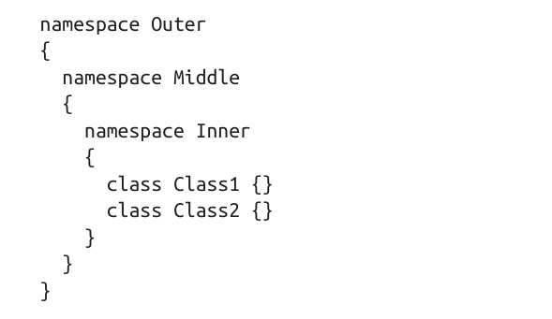
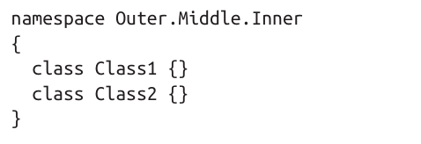
Namespace Example

Slide 6
Namespace
Let’s Practice

Slide 7
.NET Runtime
The execution environment for .NET applications.
Manages code execution, memory, security, and interoperability.
Key Responsibilities:
Compiles and executes code
Manages memory via Garbage Collection (GC)
Enforces type safety
Provides exception handling

Slide 8
CLR
The heart of the .NET Runtime.
Converts IL code into native machine code using the JIT (Just-In-Time) Compiler.
Ensures memory management, security, and exception handling.

Slide 9
Key features of clr
JIT Compilation – Converts IL to machine code.
Garbage Collection (GC) – Frees unused memory.
Exception Handling – Structured error handling.
Thread Management – Enables multithreading.
Security – Implements Code Access Security (CAS).

Slide 10
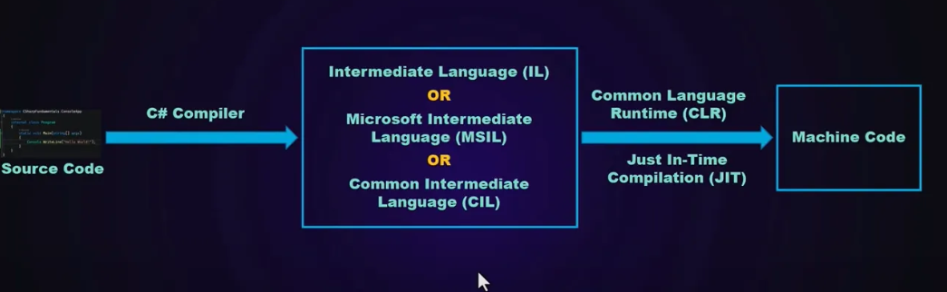

Slide 11
CLS
A set of rules and guidelines that .NET languages must follow to ensure interoperability.
Ensures compatibility between C#, VB.NET, F#, etc.
CLS Rules (Examples)
Use only CLS-compliant data types (int, float, string).
Methods must have only CLS-compliant signatures.
No case-sensitive member names (to support VB.NET).

Slide 12
BCL (Basic class library)
A core set of reusable classes provided by .NET.
Part of the larger Framework Class Library (FCL).
Includes essential functionalities: File handling, Collections, Networking, Security.

Slide 13
Key namespaces in BCL
Namespace | Purpose
System | Basic types (int, string, DateTime)
System.IO | File handling
System.Net | Networking (HTTP requests)
System.Collections.Generic | Data structures (List, Dictionary)
System.Threading | Multithreading

Slide 14
Struct
A struct in C# is a value type that is used to encapsulate small groups of related data. Unlike classes, structs are stored on the stack (instead of the heap) and are more efficient for small, immutable data structures.

Slide 15
Struct key features
Value Type: Stored on the stack, unlike classes which are reference types.
No Explicit Parameterless Constructor: Cannot define a parameterless constructor (C# automatically provides a default one).
Cannot Inherit from Another Struct or Class: But can implement interfaces.
Used for Small, Immutable Data: Ideal for lightweight objects like coordinates, colors, or points.

Slide 16
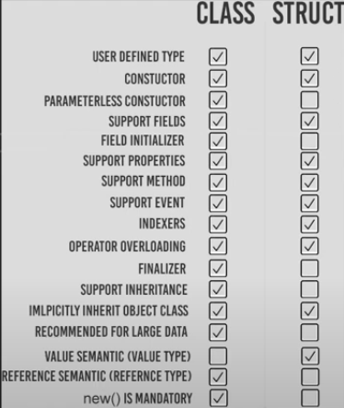
Struct VS class

Slide 17

Let’s practice

Slide 18
Operator overloading
Operator overloading in C# allows you to define how operators (like +, -, *, /, ==, etc.) work with user-defined types such as structs and classes.

Slide 19
IEnumerable

Slide 20
What is IEnumerable
An interface in System.Collections (non-generic) and System.Collections.Generic (generic).
Provides a way to iterate over a collection.

Slide 21
purpose
Enables foreach loops.
Foundation for LINQ operations

Slide 22
How IEnumerable Works
GetEnumerator() returns an IEnumerator object.
IEnumerator provides:
MoveNext(): Advances to the next element.
Current: Gets the current element.
Reset(): Resets the iterator.

Slide 23
Why Use Ienumerable ?
Abstraction: Work with any collection (arrays, lists, custom types).
Lazy Evaluation: Deferred execution (e.g., LINQ queries).
Memory Efficiency: Process data without loading entire collections.
Extensibility: Basis for LINQ and custom iterators.

Slide 24
yield return
A keyword pair used to create iterator methods that generate sequences of values on-the-fly.
Enables lazy evaluation: Values are produced one at a time, as they are requested during iteration.
Simplifies the implementation of custom iterators without manually writing an IEnumerator class.

Slide 25
Collections

Slide 26
What are collections
Objects that group related data dynamically.
More flexible than arrays (resizable, built-in methods).

Slide 27
Collections types
Non-Generic Collections
ArrayList, Hashtable (legacy, not type-safe).
Generic Collections
List<T>, Dictionary<TKey, TValue> (type-safe, performant).
Specialized Collections
Stack<T>, Queue<T>, LinkedList<T>.

Slide 28
Non-generic collections
Arraylist
Hash table
Drawbacks:
No type safety (risk of runtime errors).
Boxing/unboxing overhead for value types.

Slide 29
Generic Collections
List
Dictionary
Hash set

Slide 30
Specialized Collections
Stack<T>: Last-In-First-Out (LIFO).
Queue<T>: First-In-First-Out (FIFO).
LinkedList<T>: Efficient insertions/deletions.

Slide 31

Extension methods

Slide 32
Extension Method
A way to add new methods to existing types (e.g., string, int, or custom classes) without modifying the original code.
They "pretend" to be instance methods of the type.

Slide 33
Extension methods rules
Must be in a static class.
Method must be static.
First parameter uses this keyword (the type to extend)

Slide 34

Exercise
Create an extension method for DateTime called IsWeekend that returns true if the date is Saturday/Friday.

Slide 35

Delegates in C#

Slide 36
Delegates in C#
A delegate is a type-safe function pointer in C#.
It allows methods to be passed as parameters.
Helps in decoupling method invocation from implementation.

Slide 37
Why Use Delegates
Encapsulation of methods
Flexibility in method calls
Support for event-driven programming
Used in LINQ and functional programming

Slide 38
Multicast Delegates
A Multicast Delegate holds references to multiple methods.
It allows invoking multiple methods using a single delegate instance.
Methods are executed in the order they were added.
Use += to add methods and -= to remove methods.

Slide 39
Generic Delegates
Delegates parameterized with one or more type parameters.
Work with any type without redefining the delegate.

Slide 40
Built-in Generic Delegates
Func: Methods with a return type.
Up to 16 input parameters.
Func<int, string, bool> = bool Method(int, string).
Action: Void methods.
Action<string> = void Method(string).
Predicate: Boolean condition checks.
Predicate<int> = bool Method(int).

Slide 41

Events

Slide 42
Events
A way for a class to send notifications to other classes when something happens.
Example: A button notifying other code when it’s clicked.

Slide 43
Subscribing to an event
How to Subscribe:
Use += to attach a method:
button.Clicked += OnButtonClicked;
How to Unsubscribe:
Use -= to remove a method:
button.Clicked -= OnButtonClicked;

Slide 44
Raising Events
Check if there are subscribers.
Trigger the event with Invoke().

Slide 45
How It Works
Compiler Magic: The C# compiler converts methods with yield return into a state machine class that implements IEnumerator.
Execution Flow:
When the iterator method is called, it returns an IEnumerable object without executing the method body.
During iteration (e.g., foreach), MoveNext() advances to the next yield return, pauses, and returns the value.
The method resumes execution from the paused point on the next MoveNext() call.

Slide 46
Thank you

